Slide 1

INSTITUTE : UIE
DEPARTMENT : CSE
Bachelor of Engineering (Computer Science & Engineering)
Mobile Application Development(20CST-355)
TOPIC OF PRESENTATION:
Threads, Asynchronous task, Services-states and lifecycle, Broadcast receivers, Telephony, SMS API
Prepared by:
Parveen Kumar Saini(E13339)
DISCOVER . LEARN . EMPOWER

Slide 2
Threads, Asynchronous task, Services-states and lifecycle, Broadcast receivers, Telephony, SMS API

Slide 3
Threads

Slide 4
The main thread
Independent path of execution in a running program
Code is executed line by line
App runs on Java thread called "main" or "UI thread"
Draws UI on the screen
Responds to user actions by handling UI events

Slide 5
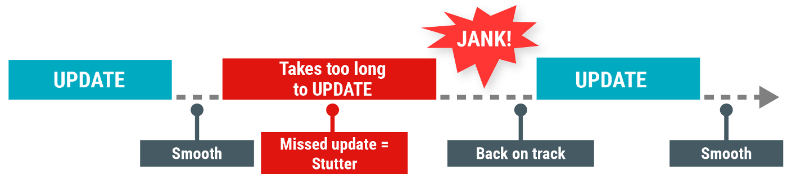
The Main thread must be fast
Hardware updates screen every 16 milliseconds
UI thread has 16 ms to do all its work
If it takes too long, app stutters or hangs
WAIT

Slide 6
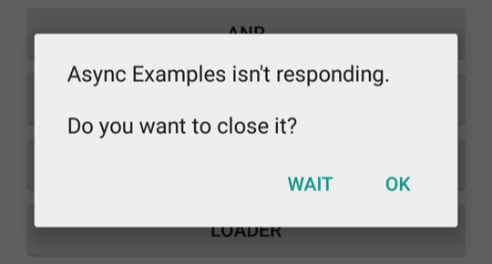
Users uninstall unresponsive apps
If the UI waits too long for an operation to finish, it becomes unresponsive
The framework shows an Application Not Responding (ANR) dialog

Slide 7
Thread of execution for the application
When an application is launched, the system creates a thread of execution for the application, called "main."
This thread is very important because it is in charge of dispatching events to the appropriate user interface widgets, including drawing events.
It is also almost always the thread in which your application interacts with components from the Android UI toolkit (components from the android.widget and android.view packages).
As such, the main thread is also sometimes called the UI thread.
However, under special circumstances, an app's main thread might not be its UI thread; for more information, see Thread annotations.

Slide 8
The system does not create a separate thread for each instance of a component.
All components that run in the same process are instantiated in the UI thread, and system calls to each component are dispatched from that thread.
Consequently, methods that respond to system callbacks (such as onKeyDown() to report user actions or a lifecycle callback method) always run in the UI thread of the process.
For instance, when the user touches a button on the screen, your app's UI thread dispatches the touch event to the widget, which in turn sets its pressed state and posts an invalidate request to the event queue.
The UI thread dequeues the request and notifies the widget that it should redraw itself.

Slide 9
When your app performs intensive work in response to user interaction, this single thread model can yield poor performance unless you implement your application properly.
Specifically, if everything is happening in the UI thread, performing long operations such as network access or database queries will block the whole UI.
When the thread is blocked, no events can be dispatched, including drawing events.
From the user's perspective, the application appears to hang. Even worse, if the UI thread is blocked for more than a few seconds (about 5 seconds currently) the user is presented with the infamous "application not responding" (ANR) dialog.
The user might then decide to quit your application and uninstall it if they are unhappy.

Slide 10
Additionally, the Android UI toolkit is not thread-safe.
So, you must not manipulate your UI from a worker thread—you must do all manipulation to your user interface from the UI thread.
Thus, there are simply two rules to Android's single thread model:
Do not block the UI thread
Do not access the Android UI toolkit from outside the UI thread

Slide 11
Broadcasts overview
Android apps can send or receive broadcast messages from the Android system and other Android apps, similar to the publish-subscribe design pattern.
These broadcasts are sent when an event of interest occurs.
For example, the Android system sends broadcasts when various system events occur, such as when the system boots up or the device starts charging. Apps can also send custom broadcasts, for example, to notify other apps of something that they might be interested in (for example, some new data has been downloaded).

Slide 12
Broadcasts overview
Apps can register to receive specific broadcasts.
When a broadcast is sent, the system automatically routes broadcasts to apps that have subscribed to receive that particular type of broadcast.
Generally speaking, broadcasts can be used as a messaging system across apps and outside of the normal user flow.
However, you must be careful not to abuse the opportunity to respond to broadcasts and run jobs in the background that can contribute to a slow system performance.

Slide 13
About system broadcasts
The system automatically sends broadcasts when various system events occur, such as when the system switches in and out of airplane mode.
System broadcasts are sent to all apps that are subscribed to receive the event.
The broadcast message itself is wrapped in an Intent object whose action string identifies the event that occurred.
The intent may also include additional information bundled into its extra field.
For example, the airplane mode intent includes a boolean extra that indicates whether or not Airplane Mode is on.

Slide 14
Sending broadcasts Android provides three ways for apps to send broadcast:
The sendOrderedBroadcast(Intent, String) method sends broadcasts to one receiver at a time. As each receiver executes in turn, it can propagate a result to the next receiver, or it can completely abort the broadcast so that it won't be passed to other receivers. The order receivers run in can be controlled with the android:priority attribute of the matching intent-filter; receivers with the same priority will be run in an arbitrary order.
The sendBroadcast(Intent) method sends broadcasts to all receivers in an undefined order. This is called a Normal Broadcast. This is more efficient, but means that receivers cannot read results from other receivers, propagate data received from the broadcast, or abort the broadcast.
The LocalBroadcastManager.sendBroadcast method sends broadcasts to receivers that are in the same app as the sender. If you don't need to send broadcasts across apps, use local broadcasts. The implementation is much more efficient (no interprocess communication needed) and you don't need to worry about any security issues related to other apps being able to receive or send your broadcasts.

Slide 15
SMS stands for Short Message Service.
It is basically a standardized communication protocol that is used for the exchange of text messages between mobile devices.
It is one of the most widely used data applications.
One can send SMS by using a smartphone, any other mobile phone, or a computer system equipped with the web, etc.
The maximum length that a text message can have is 160 alpha-numeric characters.
In the current scenario, the SMS facility is supported by GSM, CDMA, and TDMA mobile networks.
The facility of SMS is provided by all the telecommunication companies like Vodafone, airtel, idea, etc.

Slide 16
Advantages
It is a very reliable and attested platform for sending important information which ensures a guaranteed delivery of the information.
It is a more discrete form of sending information in comparison to a phone call.
It is provided automatically to all mobile devices and there is no requirement for an internet connection.
The conversations among people are automatically stored until deleted by the people themselves.
It does not require any app to be downloaded as it is already provided in all the mobile devices.

Slide 17
Disadvantages
It has a limited length as it provides only 160 characters per text message.
In order to send a text message one has to pay the cost for sending it as SMS facility is not free of cost.
There is no possibility to unsend a message once sent.

Slide 18
References
https://developer.android.com/guide/components/processes-and-threads
https://www.tutorialspoint.com/android/android_services.htm
https://www.geeksforgeeks.org/broadcast-receiver-in-android-with-example/
https://developer.android.com/guide/components/broadcasts
https://www.geeksforgeeks.org/how-to-send-sms-in-android-using-kotlin/
https://www.geeksforgeeks.org/sms-full-form/

Slide 19
THANK YOU
For queries
Email: parveen.e13339@cumail.in

